Slide 1
La Buena Salud y la vida sana
Grado 9
Los mandatos formales - afirmativos y negativos

Slide 2
Los objetivos
Al terminar esta lección las estudiantes podrán:
Identify | Identify the difference between informal and formal commands in Spanish.
Conjugate | Conjugate regular verbs in the affirmative and negative formal command form (usted/ustedes).
Conjugate | Conjugate regular verbs in the negative formal command form (usted/ustedes)
Create | Create sentences with formal commands and practice using them in role-playing or dialogues.

Slide 3

Listen and write the following advice for living a healthier lifestyle
Notes:
Mejor - better
Raciones - portion
El consumo - consumption
Al menos - at least
Azucarados - sugary
Fumar - to smoke
Energetica - energetic

Slide 4
Vamos al consultorio médico

Slide 5
Los Mandatos Formales
Formal commands are used to address a formal setting.
Who is the audience? What are some formal relationships that you can think of? Can you think of any formal relationship related to this topic?

Slide 6
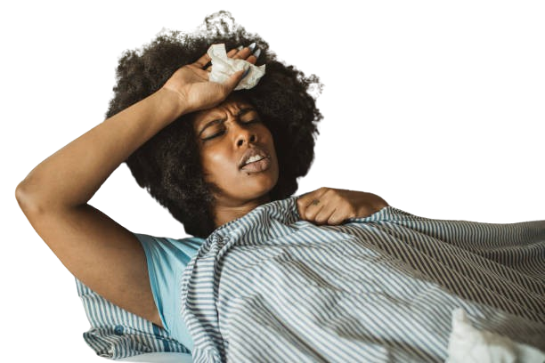
POBRECITA ANA
La Señora Ana siempre tiene dolor de cabeza por las mañanas. Cuando Ana fue al consultorio médico, el doctor escribió 3 instrucciones en un papelito:
Tome mas agua
Haga ejercicio por al menos 20 minutos al dia
Coma comida saludable
Notes:
The teacher will ask what the type of relationship is displayed in this excerpt. The teacher will ask what the instructions that were given are and how they differ from what they learned in previous weeks. The teacher will establish that these commands are formal.

Slide 7
Affirmative Usted Commands- Formation
Conjugate to Yo form of Present tense
E.g. - Bailar —--> bailo
Drop the ‘o’
bail-
Add the opposite ending - the ‘usted’ ending:
AR verb you add E
ER/IR verb you add A
baile

Slide 8
Conjugate the following list on instructions given in a doctor's visit
Vocabulary list:
Respirar
Inhalar
Doblar
Toser
Estirar
profundamente
Abrir la boca
Respirar profundamente
Inhalar por la nariz
Doblar la rodilla
Toser fuerte
Estirar los brazos hacia arriba
Can you think of any other instructions given during a doctor’s visit?

Slide 9
Case study
En grupos de dos,
Crean cuatro consejos/instrucciones para Senor Perez
Paciente: Nombre: Juan Pérez Edad: 45 años Motivo de consulta: Fatiga, aumento de peso y malestar general
Historia Clínica: Juan llega a consulta porque se siente muy cansado, ha subido de peso y se siente mal en general. Su esposa comenta que a menudo no tiene energía y se queja de estar agotado. Juan también come comida rápida como hamburguesas, papas fritas y refrescos, y casi no come frutas ni verduras. Además, pasa muchas horas frente a la pantalla jugando videojuegos y no hace ejercicio.
Evaluación Física: Juan tiene sobrepeso y su piel parece deshidratada, lo que podría ser por no tomar suficiente agua.

Slide 10
-car
-gar
-zar
verbs
Though these are regular verbs, they undergo a spell change to maintain the origins sound of the syllable. (you may have seen this in some of the negative
Can you think of any verbs that end in either -car, -gar, -zar?

Slide 11
Como cambian? Seguimos los pasos
Conjugate to Yo form of Present tense
E.g. - sacar—--> saco
Drop the ‘o’
sac-
Add the opposite ending - the ‘usted’ ending:
Sace (The problem is that this changes the sound of the ‘c’ to and ‘s’)
We solve this by using a ✨spell change✨.
saque

Slide 12
Car, gar, zar spelling changes
CAR —> QUE
GAR —> GUE
ZAR —> CE
For verbs that end in -zar, the z changes to c when it comes before the letter e

Slide 13
Negative formal commands
The negative formal commands have the same conjugations as the affirmative commands, except that the word no meaning "no" or "not" is added before the verb.
Por ej:
Coma mas verduras
No coma mas verduras

Slide 14
Upcoming Assessments
🚑Vocab test
🚑Listening test

Slide 15
Vocab list!
Respirar
Inhalar
Doblar
Toser
Estirar
Profundamente
El consumo
Azucaradas
Aumento
Peso
Malestar
La pantalla
La piel
Deshidratada
Mejor
Raciones
Al menos
Fumar
Energética

Slide 16
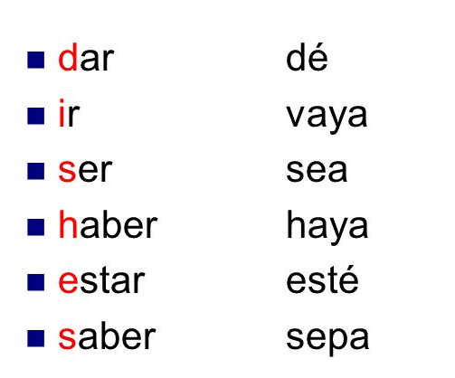
Irregular usted commands
Focus on the words with arrows. We use them more frequently

Slide 17
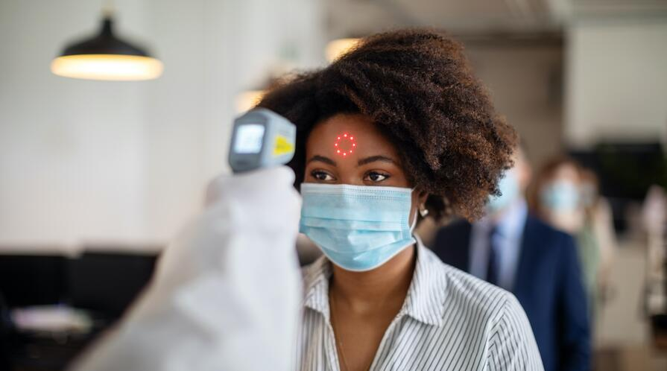
Vamos a pensar en el pandémico.
Can you remember any of the instructions that we had to obey during the pandemic?
Was the audience plural or singular?

Slide 18

Plural Commands
The plural command is neither formal nor informal. It is simply a command to more than one person whether a group of friends or two presidents at a meeting

Slide 19
Plural Commands
Baile Ud.
Bailen Uds.
Coma ahora
Coman ahora!
What do we observe about the plural command?

Slide 20
Plural Commands
Correct! The plural command is formed by simply adding ‘n’ to the formal command!
NB: Even the irregulars!

Slide 21
Let’s do all commands all together
Verb | Tu aff | Tu neg | Usted aff | Usted neg | Plural/ustedes
Cuidar
Descansar
Prevenir
Relajarse
Correr
Saber
Ser

Slide 22
Remember the reflexive verbs?
When forming the reflexive positive command (formal) all rules regarding the reflexive positive command are maintained. In the usted command, however, the pronoun for usted is used. I.e. - SE
Note the placement of the reflexive pronoun!!!
Cuidarse - to take care of one’s self
Cuídese - Positive formal command
No se cuide - Negative formal command

Slide 23

Think again of the pandemic: COVID 19
Protéger – To protect
Lavarse – To wash
Cuidar – To care for
Desinfectar – To disinfect
Usar – To use
Evitar – To avoid
Mantener – To maintain
Distancia – Distance
Prevención – Prevention
Salud – Health
Síntomas – Symptoms
Quedarse – To stay
Vacuna – Vaccine
Fortalecer – To strengthen
Respeto – Respect
Can you create instructions for the public, using the list of words to the right:

